Slide 1

Toronto District School Board
Grade 8 to 9
Transition Information Session for the
2018-2019 School Year

Slide 2
Goals for the Evening
Choices for Nine
To inform students, parents & guardians about high school choices in order to make a smooth and successful transition from Grade 8 to 9
To assist students, parents & guardians in making informed choices about courses, programs and schools
To raise student, parent and guardian awareness of the various program pathways available throughout the Toronto District School Board

Slide 3
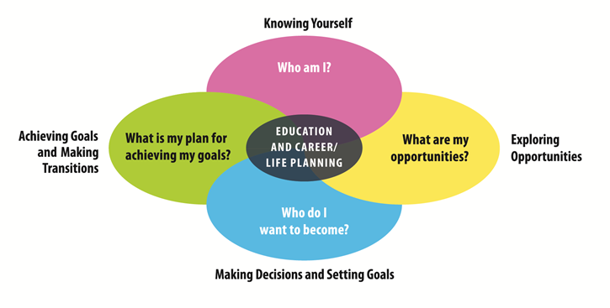
Creating Pathways to Success, 2013
Notes:
Creating Pathways to Success is a Provincial Policy document that guides Educational and Career/Life planning from Kindergarten through to Grade 12. Making choices and transitioning from Grade 8 to Grade 9 for students and families is an inquiry approach.
Tonight you may have come to this information evening:
with many questions
seeking answers
guided by possible future thinking
Your decisions may be guided by these 4 questions:
What you know about your child (e.g., Achievement, learning styles, interests abilities, passions, etc) (Who am I?);
Thoughts and ideas about possible postsecondary plans (hopes and dreams) ;
What kinds of programming including extra-curricular activities are available
(Opportunities);
Goals and decisions for getting there will include: course types, learning styles, learning goals and work habits, etc. (Who do I want to become?);
What plan are we making for now and the future? (Achieving Goals);
This type of strength based framework encourages students with support from their family and teachers, to continue to return to these questions as they grow and develop.
This is where the Individual Pathways Plan (IPP) process is very helpful as students revisit and revise the plan along the way through their High School experience.

Slide 4
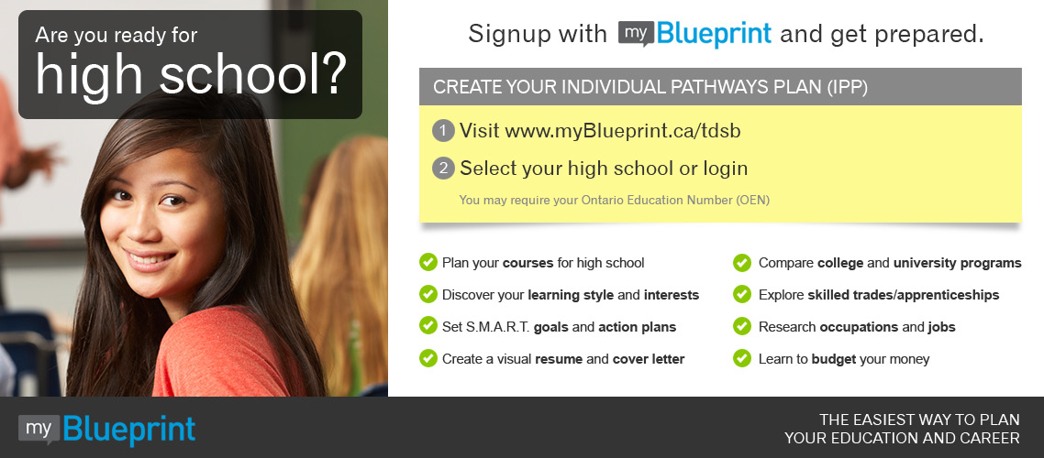
Accessing myBlueprint.ca/tdsb
Online educational & career planning tool for students and parents
www.myBlueprint.ca/tdsb Activation Key: tdsb
Notes:
Key Message:
myBlueprint is a career and post-secondary planning tool provided by the TDSB
Designed for present and future planning (e.g. High School Planner/Post-Secondary Planner/Occupation Planner).
All students in Grades 7 to 12 in the province will have access and support with educational planning through this web-based tool.
Parents may have their own myBlueprint account, or be linked to their child’s account for planning and conservation purposes.
Tutorials and videos on how to best utilize the site are available for parents on the myBlueprint site.
School specific offerings (Specialization, Elective courses offered , future planning (e.g., Specialist High School Major - SHSM).
Allows students to navigate many and varied pathways to success.
Designed for present and future planning (e.g., High school Planner/Post-Secondary Planner/Occupation Planner).
All students will complete an Individual Pathways Plans and that myBlueprint is the tool with activities that we use to contribute to the IPP
We encourage students to make the plan their own by including: media that demonstrates their interests, talents, learnings, growth, passions, pictures, that round out who they are in Grade 7,8,9,10 etc.

Slide 5
What Can Families Do to Help Students Make the Best Choices?
Choices for Nine
Access and investigate myBlueprint career planning tool
Attend ANY Secondary Information Evenings/Open Houses of interest including Regular or Specialized Programs
Encourage continued participation in extracurricular activities
Choose courses of interest
Discuss future plans
Stay involved and connected with the school
Contact your school’s Elementary Itinerant Guidance Counsellor
Notes:
Key Messages:
Students, parents and guardians will find details on Secondary Information Evenings and Open Houses with dates and times on the TDSB website -
http://www.tdsb.on.ca/HighSchool/GoingtoHighSchool/OpenHousesandInformationNights.aspx

Slide 6
Choices for Nine
Information Evenings/Open Houses
at TDSB High Schools
Program and school specific information is shared
Updated dates and times of High School Information Evenings are posted on the TDSB website by accessing the link below:
http://www.tdsb.on.ca/HighSchool/GoingtoHighSchool/OpenHousesandInformationNights.aspx
Notes:
Key Messages:
Parents are strongly encouraged to attend their secondary home school information evening along with other schools they are considering through optional attendance.
Benefits of attending these evenings:
Get a feel for where your child will be spending the next 4 years;
Ask questions related to academic support and extra-curricular programs;
Speak personally with teachers and administrators ;
Listen and speak to school representatives and formulate personal thoughts on the fit for their child;
Visiting the school enables students and their families to make informed decisions about their child’s high school career.
Re-emphasize:
High school information nights will be listed on the website only; Beyond 8: Choices for 9.

Slide 7
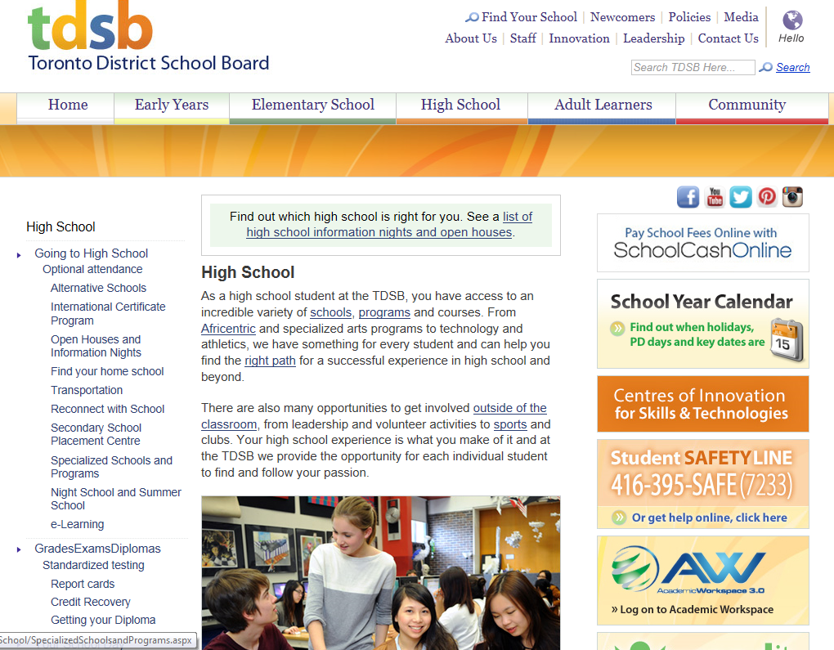
How to Access Secondary Information Evenings and Open Houses:
Choices for Nine
Notes:
Key Messages:
Students, parents and guardians will find details on Secondary Information Evenings and Open Houses with dates and times on the TDSB website -
http://www.tdsb.on.ca/HighSchool/GoingtoHighSchool/OpenHousesandInformationNights.aspx

Slide 8
Considerations When Choosing a High School
Choices for Nine
The range of subjects and programs offered in each grade
Semester and non-semester schedules
“Composite” schools and “Alternative” schools
The size of the school – big or small settings
The range of extracurricular activities, clubs and sports offered
The supports available for English Language Learners and students with special education needs
Location from your home address
Where does your child want to go?
Notes:
Key Messages:
Students in the Regular, French Immersion and Special Education programs in TDSB schools are encouraged to attend the secondary school in their designated attendance area.
For some students with specific interests, skills and learning needs/styles, investigating other secondary school options may be appropriate.
Students should explore schools of all sizes and program availability – an example would be Alternative Schools.
Composite Schools: For children of all abilities and offer all program types Alternative Schools: Alternative schools are places where students find their way through learning environments that vary widely and often include self-directed projects, experiential learning, business and entrepreneurial mentorship programs, strong co-op programs and credit recovery opportunities (which all schools also have) - all while earning OSSD credits.

Slide 9
Choices for Nine
The Year Ahead: Educational Planning and Course Selection Process
Planning for the coming year is a process (myBlueprint)
That process begins now and will continue until Course Selection Sheets are due in late February
www.tdsb.on.ca/GoingtoHighSchool
Notes:
Key Messages:
The process will include:
The use of myBlueprint for the completion of Individual Pathways Plans and the Course Selection Process
Gathering information about Specialized Schools and Programs

Slide 10

Find Your School
Choices for Nine
www.tdsb.on.ca
Click on “Find your School”
Notes:
Key Messages:
First entry point is to encourage families to consider their secondary home school.
The home school is based on the student’s residential address.
There are many ways in which academic and extra-curricular interests can be met at the secondary home school.
All TDSB schools strive to offer a wide range of academic and extra-curricular programming designed to meet student needs, interests and passions.
Optional Attendance to Specialized Schools or Programs is for students who have a passion in an area of specialty.

Slide 11
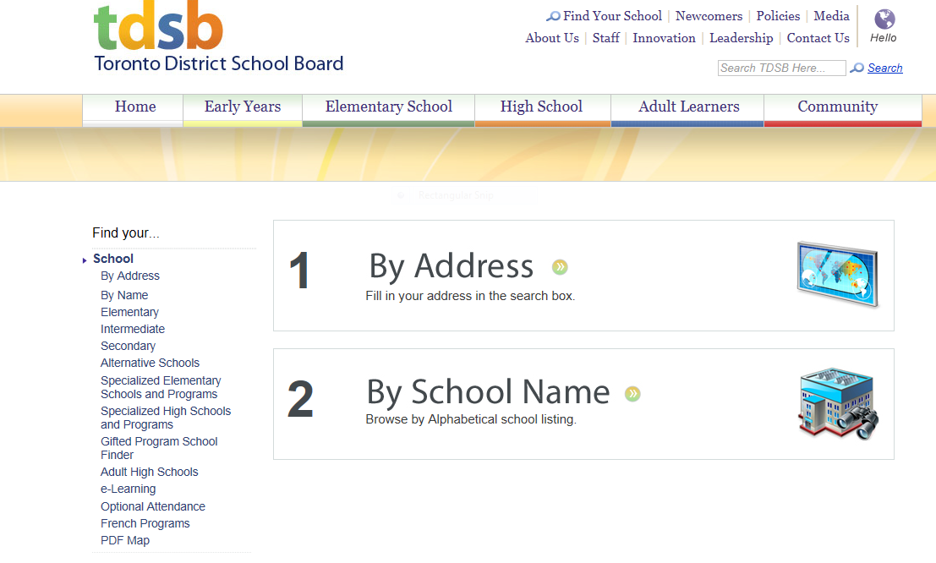
Find Your School
Choices for Nine
Find your school by selecting how you want to search.
Notes:
Key Messages:
Parents can type in their home address when they click on ‘By Address’ to find the secondary school in their area.

Slide 12
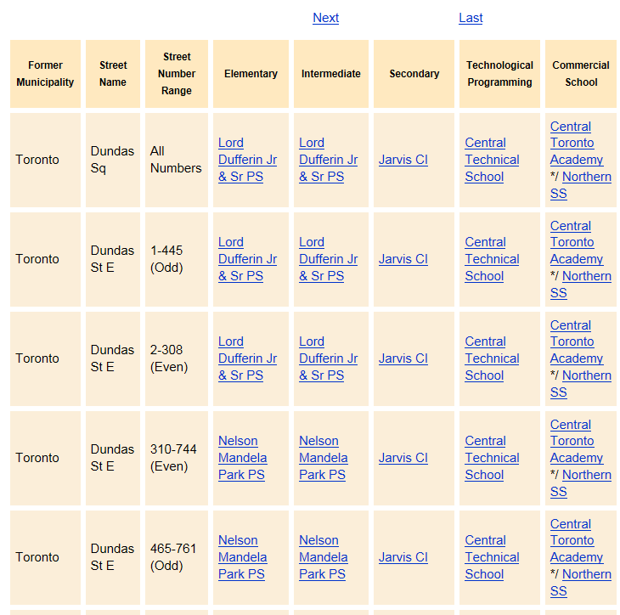
Choices for Nine
Notes:
Key Messages:
Based on Address, you will find which Secondary, Technical, Commercial and Business Schools are available. But remember, ALL schools offer the same course types no matter what the school designation.

Slide 13
Making Course Choices
Choices for Nine
Ultimately, students and families make the final course choices
Counsellors as well as your child’s Grade 8 teachers are there to offer their best suggestions about course choices based on evidence of a student’s achievement, learning style, interests, and learning goals
All Grade 8 students will complete a course selection sheet for their home school
Notes:
Key Messages:
This should be a collaborative effort:
You and your child will have your own ideas regarding course choices – make sure they are taking courses which align with their achievement, learning styles, interests, and abilities;
Grade 8 teachers and counsellors can be asked to provide suggestions based on their academic assessments;
Secondary schools will review the evidence of achievement from report cards and transition meetings;
Using all of the information available, students and families make the final decision.

Slide 14
What Course Type Choices Do Students Make in Grades 9 and 10? As per Ontario Schools, Kindergarten to Grade 12: Policy and Program Requirements, 2016 (OS)
Choices for Nine
Applied
Academic
Locally Developed
Open
Students can mix course types based on their achievement, interests, and skills.
Notes:
Key Messages:
Emphasize that all course types , especially in Grade 9, open doors to all destinations -the journey will be as varied as the unique learners that choose them.
Programs of study should be carefully considered and tailored to the student’s strengths and interests.
For example, a student may take applied French and academic Math.

Slide 15
Choosing Course Types
Choices for Nine
Let’s listen to Jenna who will outline the different Course types available for you to choose from for Grade 9:
Course Types to Choose From
Notes:
Key Messages:
This should be a collaborative effort:
You and your child will have your own ideas regarding course choices – make sure they are taking courses which align with their achievement, learning styles, interests, and abilities;
Grade 8 teachers and counsellors will give recommendations based on their academic assessments;
Secondary schools will review the evidence of achievement from report cards and transition meetings;
Using all of the information available, students and families make the final decision.

Slide 16
Open Course Types
Choices for Nine
Open Courses
Optional courses that prepare students for further study and enriches the learning
These courses include (but not limited to):
Art, French, Music, Health and Physical Education, Social Sciences and the Humanities
‹#›
Notes:
Key Messages:
A common set of expectations for all.
Open courses compliment all pathways.
They are not considered “destination” based - meaning there is no pre-requisite for a Grade 11 course.

Slide 17
Locally Developed Course Types
Choices to Nine
Locally Developed:
Compulsory courses for students provides more flexibility and support in learning
Together with our Special Education Department, we will collaborate to develop the best transition plan and program course type for your child
Courses that may be developed locally include:
English, History, Math, and Science
Notes:
Key Messages:
Locally Developed courses were previously referred to as ‘Essentials’;
Locally Developed courses accommodate educational and/or career preparation needs.

Slide 18

Ontario Youth Apprenticeship Program (OYAP) Pathways Chart Comparison
Choices for Nine
Notes:
Key Messages:
Students who participate in Cooperative Education in an apprenticeable trade are able to participate in the Ontario Youth Apprenticeship Program (OYAP) while they are still in secondary school. This program allows them to start working on post-secondary apprenticeship qualifications right away.
OYAP starts in Grade 11 or Grade 12 through the Cooperative Education program. Students in the Toronto District School Board (TDSB) have opportunities to become registered apprentices and work toward becoming certified journeypersons in a skilled trade while completing their secondary school diplomas.

Slide 19
What Are the Graduation Requirements?
Choices for Nine
Ontario Secondary School Diploma (OSSD)
Total of 30 course credits
– 18 compulsory courses – 12 elective courses
40 Hours Community Involvement
– Begins in summer after Grade 8
Ontario Literacy Requirement
- Ontario Secondary School Literacy Test
Ontario Schools, Kindergarten to Grade 12:
Policy & Program Requirements, 2011
Notes:
Key Messages:
Credits
Students in Grades 9 and 10 will take 6 compulsory credits.
In Grades 9 and 10 , students will choose 2 elective credits each year (NB. Students with learning exceptionalities may be recommended for GLE (GLS where offered for some students) and therefore may only have 1 elective to choose from).
In Grades 11 and 12, students will have an opportunity to choose from a variety of elective courses.
Community Involvement
Students may begin community involvement activities as part of graduation requirements in the summer following Grade 8.
Community involvement activities for graduation requirement must not be part of any other program for which students receive credit: i.e. pay, badges, certification, etc.
Must be completed outside of regular classroom time - before, after school, during lunch period, or on week-ends.
Parents/guardians encouraged to be involved in monitoring appropriate volunteer activities for their children.
Students receive Community Involvement Passport at the end of Grade 9 in which to record volunteer experiences and track hours.
Students will be provided with a listing of activities which meet the criteria for community involvement (at times, they are asked to discuss with their guidance counsellor before beginning).
Literacy Test
Students will write the Literacy Test in the Grade 10 year.
Students who are unsuccessful on the first attempt at the Ontario Secondary School Literacy Test (OSSLT) may:
Attempt the test the following year OR
Enroll in the Literacy Course (credit course)

Slide 20
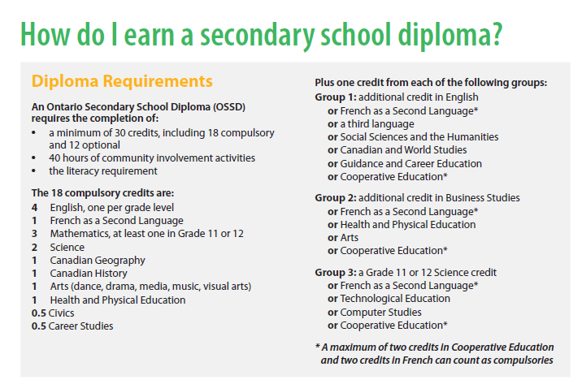
Choices for Nine
Ontario Secondary School Diploma (OSSD)
Ontario Schools, Kindergarten to Grade 12:
Policy & Program Requirements, 2011
Notes:
Key Messages:
Credits
Students in Grades 9 and 10 will take 6 compulsory credits.
In Grades 9 and 10 , students will choose 2 elective credits each year (NB. Students with learning exceptionalities may be recommended for GLE (GLS where offered for some students) and therefore may only have 1 elective to choose from).
In Grades 11 and 12, students will have an opportunity to choose from a variety of elective courses.
Community Involvement
Students may begin community involvement activities as part of graduation requirements in the summer following Grade 8.
Community involvement activities for graduation requirement must not be part of any other program for which students receive credit: i.e. pay, badges, certification, etc.
Must be completed outside of regular classroom time - before, after school, during lunch period, or on week-ends.
Parents/guardians encouraged to be involved in monitoring appropriate volunteer activities for their children.
Students receive Community Involvement Passport at the end of Grade 9 in which to record volunteer experiences and track hours.
Students will be provided with a listing of activities which meet the criteria for community involvement (at times, they are asked to discuss with their guidance counsellor before beginning).
Literacy Test
Students will write the Literacy Test in the Grade 10 year.
Students who are unsuccessful on the first attempt at the Ontario Secondary School Literacy Test (OSSLT) may:
Attempt the test the following year OR
Enroll in the Literacy Course (credit course)

Slide 21
Choices for Nine
Optional Attendance
Students are encouraged to attend the high school within the catchment area of their residential address (home school)
Use an Optional Attendance Application Form (PR545) when applying to a school other than your home school
Forms will be available at the Grade 8 school in January *Specialized Programs may have earlier deadlines. Please review school specific deadlines for more information
Specific information regarding Optional Attendance Procedures will be communicated to students and families in early January
www.tdsb.on.ca/FindyourSchool/OptionalAttendance
Notes:
Key Messages:
High school information nights will be listed on the TDSB website

Slide 22
Important Dates
Choices for Nine
February 1, 2019 Optional Attendance applications due to secondary schools – delivered by student/parent/guardian
February 15, 2019 Secondary schools will inform Optional Attendance applicants by this date
February 22, 2019 completed via myBlueprint and returned to elementary teacher/counsellor
March 1, 2019 All course selection sheets due to secondary schools – delivered by Elementary Counsellor
Note:
Only ONE course selection per student is submitted for
ONE secondary school by the elementary school counsellor
Notes:
Key Messages:
January
List of “Closed” and “Limited” schools made available; and
Optional Attendance applications available from elementary schools.
Distribution of Course Selection Sheets and/or myBluerprint course selection begins; and Parents/guardians are encouraged to consult the Beyond 8: Choices for 9 for information.
Parents/guardians are encouraged to be involved in their child’s educational planning through ongoing consultation with teachers and counsellors. Reviewing myBlueprint will also be helpful as descriptors are provided for the course types for Grade 9 and beyond.
Note for Teacher/Counsellors:
Establish the date with students for return of completed course selection sheets / myBlueprint. This will ensure that you have the course selection sheets submitted electronically to the secondary schools within the required timeframe.

Slide 23

Questions?
Choices for Nine

